Slide 1
Analysis of Customer Buying Behavior
Bei Wang
06.20.2021
CS544 2021 Summer1

Slide 2
CONTENTS
1
Data Set Overview
2
Goal of Analysis
3
Data Preparation
4
Analyze Buyers
5
Central Limit Theorem
6
Sampling
7
Conclusion
8
Reference

Slide 3
1
Data Set Overview
The data set was created from information collected from a Kaggle survey to do the survey of customer's behavior. The data represents details about 400 clients of a company including the unique ID, the gender, the age of the customer and the salary.(Data set source: https://www.kaggle.com/denisadutca/customer-behaviour)

Slide 4
2
Goal of Analysis
Due to the limited customer background provided by the data, this analysis will focus on the customers who have purchased behavior. The purpose of analysis is to collect information about purchasing decisions and analyze the relationship between these factors. In this way, we can know what factors affect people's purchasing decisions? Age, salary or gender?

Slide 5
3
Analyze Buyers

Slide 6
Analysis of Customer Buying Behavior
Analyze Buyers
Data Preparation
The data analysis of this project is only based on the people who have purchased. So I subset the data set by selecting “purchase=1”.
I did a few things of preparation:
1. Check if null data in the dataset: there is no null data in the dataset.
2. Rename of column: rename “EstimatedSalary” to “Salary”.
3. Create the subset of purchased.
4. Separate Data set into the age groups: age 18~24, age 25~34, age 35~44, age 45~54, age 55~60 by breaks and counts in hist.

Slide 7
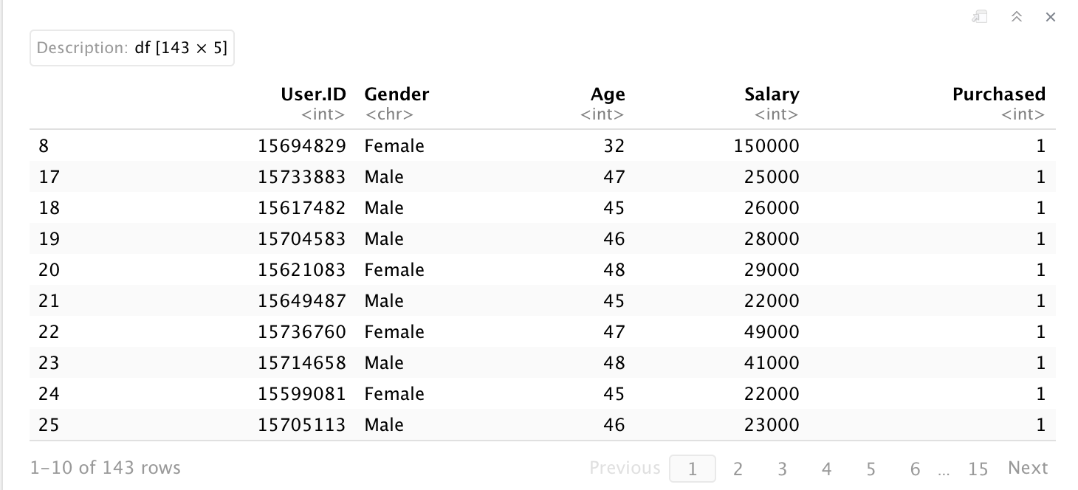
Analysis of Customer Buying Behavior
Analyze Buyers
Overview of Dataset
The part of orginal data set

Slide 8
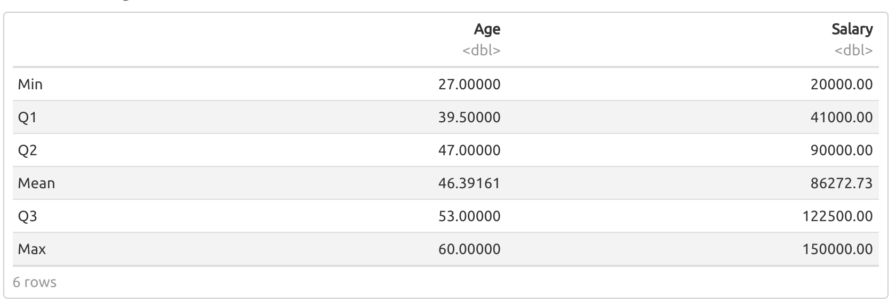
Analysis of Customer Buying Behavior
Analyze Buyers
Summary
There are two numerical variables in the data set: Age and Salary. Let's see the summary of them.

Slide 9
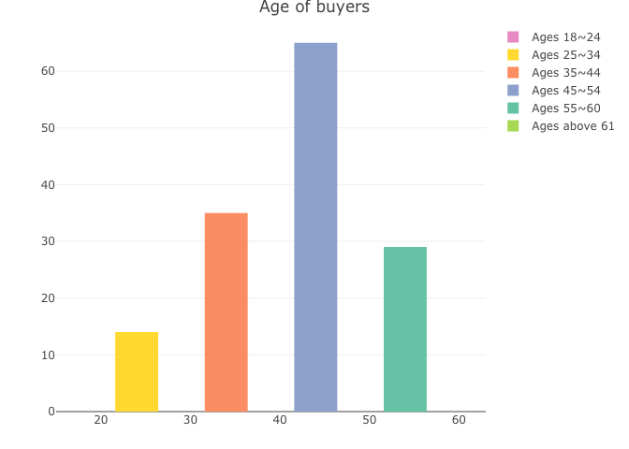
Analysis of Customer Buying Behavior
Analyze buyers
Age of Buyers
First look at the age distribution of buyers. The age of buyers is concentrated between 25 and 54 years old. the age range from 35 to 45 years old accounted for 45%; followed by 25 to 34 years old, accounting for about 24%; 45 to 54 accounted for about 20%, the overall distribution plot is slightly skewed right. From a set of data, it can be basically considered that the age from 25 to 54 is the buying group, and the 45 to 54 is the main buying group.

Slide 10
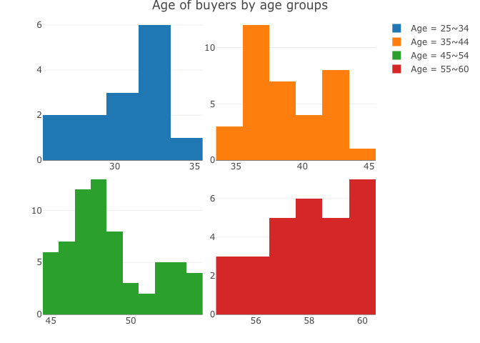
Analysis of Customer Buying Behavior
Analyze Buyers
Age of Buyers

Slide 11
Analysis of Customer Buying Behavior
Analyze Buysers
Salary of Buyers
In addition to the age factor, is the income of each age group also one of the factors affecting purchasing power?
It can be seen from the plot that people aged from 25 to 34 for the highest income, and the income range is small, with the middle position reaching 121.5k. The second is 35 to 44 year, the income in this range is a bit larger, but the middle position has reached 108k. The income range of 45 to 54 has obviously widened, but at the same time the highest value has also fallen, even lower than the median of the previous age group. When the age is greater than 55, the overall income range increases and the range expands.A interesting thing is: from the last plot, we know the age range 45 to 54 is the main buying group, but the salary's range is lowest than other group. so,in this project, the high salary is not the key factor to affect the buying power.

Slide 12
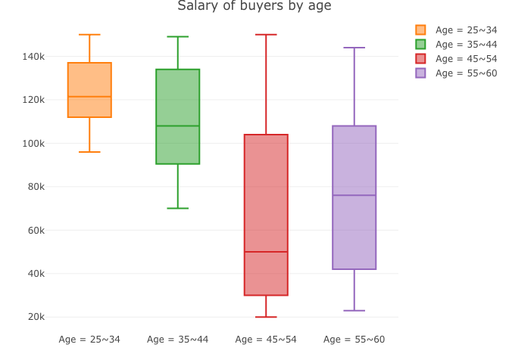
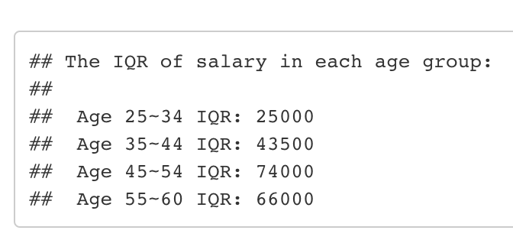
Analysis of Customer Buying Behavior
Analyze Buyers

Slide 13
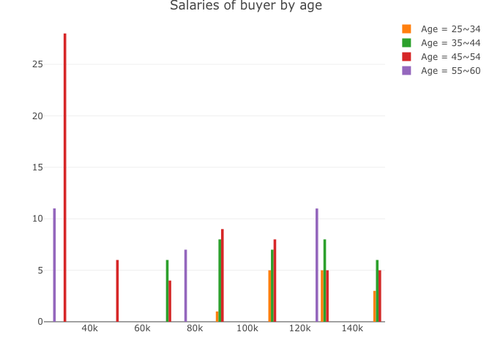
Analysis of Customer Buying Behavior
Analyze Buyers

Slide 14
Analysis of Customer Buying Behavior
Analyze Buyers
Gender of Buyers
MAN
35~44 male shop more than female
People usually think that women love shopping more than men. Is this true? In the plot below, we will find there are not bigger different of female and male buyers between the age below 25 and order than 55. But in age 45 to 54, female buyer obviously more than male; but in age 35 to 44, the male buyer will shop more times than female.
FEMALE
45~54 female shop more than male

Slide 15
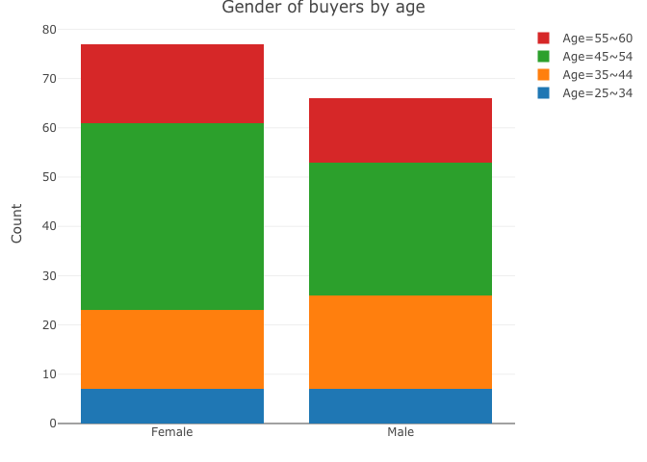
Analysis of Customer Buying Behavior
Analyze Buyers
Among all buyers, femal accounted for 53%, and male accounted for 46%. Female buyers are more than male.

Slide 16
4
Central Limit Theorem

Slide 17
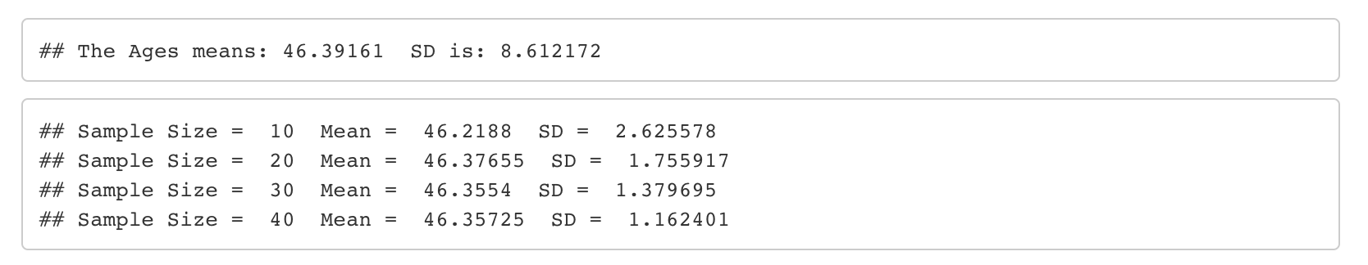
Analysis of Customer Buying Behavior
Central Limit Theorem
“The Central Limit Theorem states that the distribution of the sample means for a given sample size of the population has the shape of the normal distribution. The theorem is shown with various distributions of the input data in the following sections.” Along with the sample size gets larger, the means of the samples become a normal distribution. Use the central limit theorem to show the age variable of the data set. As shown in the bar plot and histogram above, the age distributions of all groups are skewed to the right. I will use this as an example to illustrate the application of the central limit theorem. The histogram below shows the sample means of 1000 random samples with sample sizes of 10, 20, 30, and 40, which follow a normal distribution.
Notes:
the SDs are getting smaller along with the size of random samples increased.

Slide 18
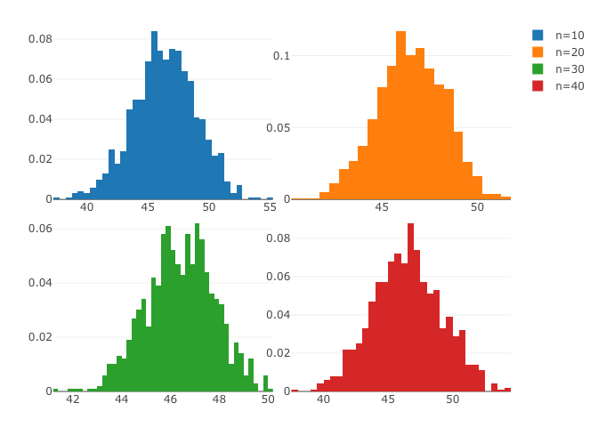
Analysis of Customer Buying Behavior
Central Limit Theorem
Notes:
the shape of plots from skewed right to the normal distribution.

Slide 19
5
Sampling

Slide 20
Analysis of Customer Buying Behavior
Sampling
"A sample is a portion of the population that is selected for doing the data analysis. The results from this sample are then used to estimate the characteristics of the population." Sampling will greatly help us save working time, reduce workload, and reduce the difficulty of analysis. There are many different type of sampling.I randomly select 20 samples from customers who have purchased by age, and do analysis with perform simple random sample, Sample Random Sampling Without replacement, and Systematic sampling. Based on the size of each age, I only strata one sample from the each layer to do stratified sampling analysis.

Slide 21
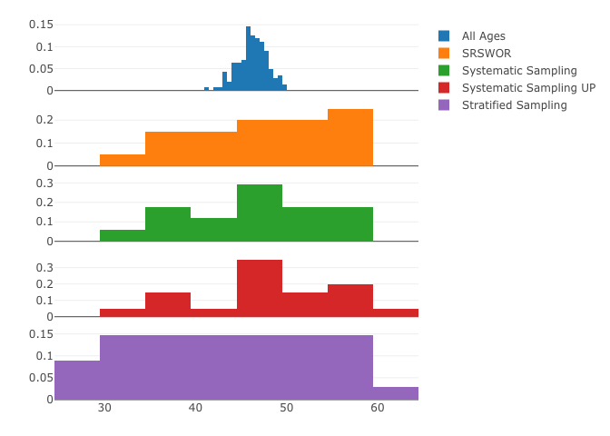
Analysis of Customer Buying Behavior
Sampling

Slide 22
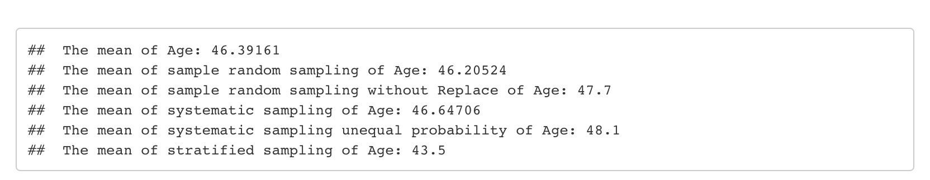
Analysis of Customer Buying Behavior
Sampling
The means of sample using simple random sampling without replacement and systematic sampling are similar with the mean of data;
The mean of unequal probabilities sample random sampling without Replace and systematic based on inclusion probabilities using the age variable is bigger then mean of data;
Stratified sampling using proportional is less than the mean of data. It may be caused by the limited size of each age in age variable.
Stratified sampling is good for big data set and big difference between the data; Sample random sampling is good for small size data size and no big difference between the data. Therefore, in this project the mean of SRS is closest to the orgianl mean.
Notes:
when I was doing Stratified sample,there is an error, the problem is caused by the size of each age, the minimum size is 1 for each age in the original data set. If I select more than the minimum size of each age, it will report an error. So I only was allowed to strata one sample by 34 times in stratified sampling analysis. It works. 34 is the count of the frequence of the data.
However, since only 1 sample is allowed to be drawn in each layer, the final mean does not have the mean that most close to the mean of original data.

Slide 23
6
Relationship Between Variables
Going back to the original question, compare the age, gender, and income provided by customers who have made purchases to see what kind of relationship they have.

Slide 24
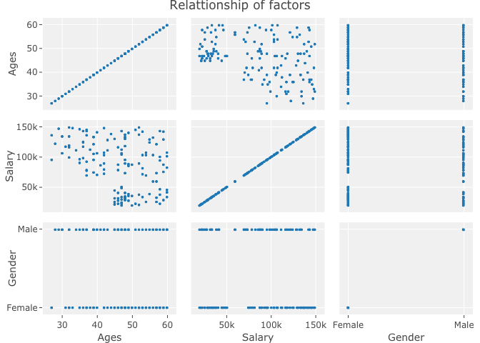
Analysis of Customer Behavior
Relationship Between Variables

Slide 25
Analysis of Customer Behavior
Relationship Between Variables
It can be seen from the plot that the sharp between age and salary is related, but it is not much related to gender. After calculation the correlation of age and salary, result is -0.369, the relationship can be considered that age and income have a negative relationship.

Slide 26
7
Conclusion

Slide 27
Analysis of Customer Behavior
Conclusion
In summary, among all buyers, middle-aged and elderly people with lower incomes are more keen on shopping; gender factors make a little difference in shopping behavior.
Therefore, foucus on middle-aged and elderly people, sell products corresponding to the lower and higher income categories, take into account both female and male products. That will be a huge market.

Slide 28
8
Reference

Slide 29

Analysis of Customer Behavior
Reference
1. Module 3 & 5 PDF of CSS544
2. Plotly R Graphing Libraries: https://plotly.com/r/

Slide 30
THANK YOU
Bei Wang
CS544 2021 Summer1

